Slide 1
Customer Relationship
Management (CRM)
MKTG 571:
Professor: Andrew Petersen

Slide 2
Today’s Agenda
Motivation for this course
Course philosophy
Course requirements

Slide 3




The Traditional Marketing Paradigm
(the 4 Ps)
Customers
Segmentation & Targeting
Product
Price
Target
Market
Company
Positioning &
Differentiation
Promotion
Place
Competitors

Slide 4
The Evolution of Marketing
Era
Orientation
Organization
‘Good old days’
Mass
market
Large
Segments
Niche
Segments
Customer
Centric
Customer
Orientation
Product
Orientation
Market
Orientation
Customer
Orientation
Mom and Pop
Product
Organization
Market
Organization
Customer
Organization

Slide 5
Product-Centric vs. Customer-Centric
Marketing Marketing
Product Focus
Transactions/Sales
Market Share
Product Profitability
Brand Loyalty
Product Lifecycle
New Product Development
Customer Focus
Relationships
Share of Customer
Customer Profitability
Customer Loyalty
Customer Lifecycle
Customer Development

Slide 6
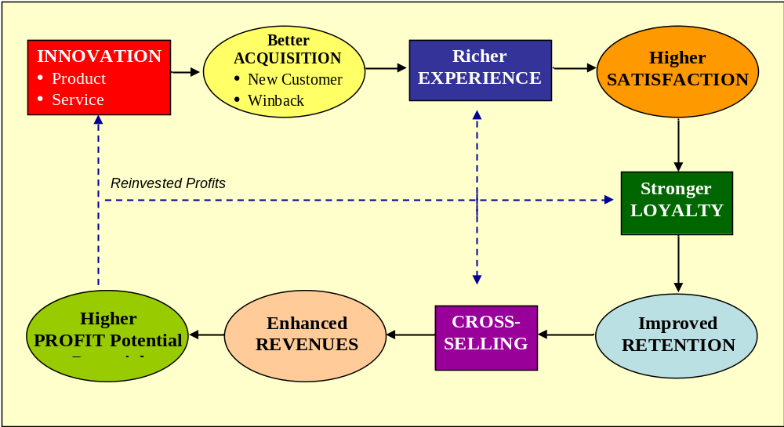
The Conventional Path to Profitability

Slide 7
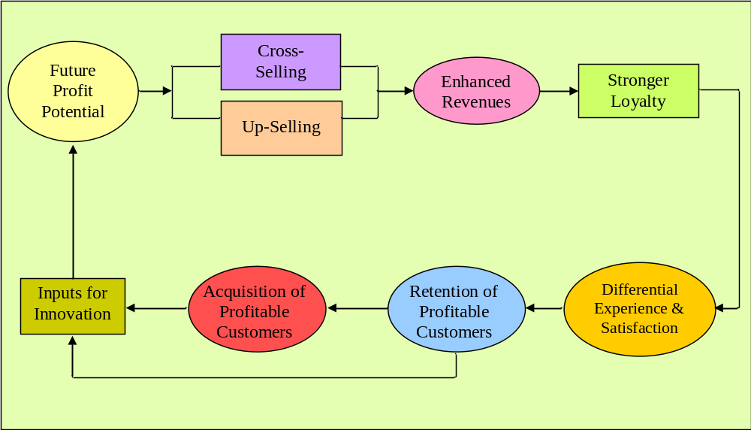
Reversing the Logic

Slide 8
Customer Information
As more detailed information is captured
  Credit and debit card transactions
  Travel – airlines, hotels
  Internet and catalog purchases
  Web surfing
  Retail loyalty card data
  Magazines
  Netflix, pay-per-view
  Customer support calls
  Self-provided information on preferences, demographics
The information can be used for a firm’s advantage

Slide 9
The Potential of Customer Information
Calculate customer value to the firm
Segment or tier customers
Target customized offers
  The right product at the right price at the right time in the right place …
Predict and prevent customer attrition
  Develop models to identify lapsed and “at risk” customers
Build customer loyalty

Slide 10
The Challenges of Customer Information
Customer data is hard to collect, clean, combine, and centralize
Most firms are organized around products and markets, not customers
  Organizational incentives are typically not aligned with customer-centric marketing
The amount of data is massive and typically requires complicated analysis
  Marketers are usually poor at analytics, and statisticians are usually poor at marketing

Slide 11
Components of CRM
Goals and Objectives
(the vision)
Strategic
Strategic
Day-to-Day Implementation
(the arms & legs)
Operational
Analytical
Analytical
Customer Intelligence
(the brains)

Slide 12
Focus of this Course
Strategic and Analytical course addressing issues, topics, tools and terminology associated with managing customers as assets
Strategic Topics
  Customer Profitability and Value
  Customer Tiering
  Customer Acquisition
  Customer Loyalty and Loyalty Programs
  Cross-selling and Up-selling
  Customer Retention and Attrition
  Market Experiments/AB Testing
  Customer Metrics
Tools
  Decile Analysis
  Customer Lifetime Value
  RFM Segmentation
  Predictive Modeling
    Decision Trees (CHAID)
    Logistic Regression
    Linear Regression

Slide 13
Key Themes
Customer-centric marketing
Statistical modeling of customer information
Strategic customer-focused Initiatives
The course is a blend of both the art and science of managing customer relationships.

Slide 14
I. Customer-Centric Marketing
What is customer-centric marketing?
Customer lifecycle
Customer economics
Customer segmentation and tiering
Customer metrics

Slide 15
II. Statistical Modeling of Customer Information
Types of Predictive Models
  Heuristics, Statistical Models, Data Mining
RFM Segmentation (Heuristic)
Decision Trees (Data Mining)
Evaluating Models
  Lift, Gains, ROMI

Slide 16
III. Strategic Customer-Focused Initiatives
Customer Acquisition
Customer Development
  Loyalty Programs
  Cross-selling
  Up-selling
Customer Attrition and Retention
Customer Win-back

Slide 17
Goals of the Course
To give you a solid foundation in customer-centric marketing.
To show how strategic CRM combined with marketing analytics can help accomplish marketing initiatives and boost profitability
To increase your analytical skills through exposure to commonly used customer metrics and analytical techniques

Slide 18
Course Components
1/3 theory and concepts
1/3 current practices and examples
1/3 cases and exercises
Emphasis will be on B2C information-rich contexts but with a B2B case and relevance to B2B
Case Settings:
  Major hotel
  Consumer direct mail and catalog firms
  Online DVD rental
  Supermarket chain

Slide 19
Course Details
Class sessions will be a mixture of:
  Case analysis
  Discussion of readings
  Lecture
Rely on course website for preparation questions and assignments
To minimize your costs, I have placed most documents on the website
Readings and Class Slides
  Downloads from course website

Slide 20
Grades and Assignments
Team Case Writeup: Hilton Hotels: Brand Differentiation Through CRM | 15%
Individual Case Writeup: Tuscan Lifestyles: Assessing Customer LTV | 15%
Individual Problem Sets: Predicting Response at BookBinders: Logistic Regression Predicting Response at BookBinders: Decision Trees | 10% 10%
Team Case Writeup: Netflix: The Customer Strikes Back | 15%
Class Participation | 10%
Final Exam | 25%
Total | 100%

Slide 21
Other Course News
CE/CLV Contest
  Predict customer donation behavior and win a prize!
  Due Thursday, April 20th

Slide 22
Course Website
Comprehensive course guide
Contains required readings
All other course information
Access through Canvas

Slide 23
What You Can Expect of Me
Rigor and meaning
Relevant deliverables
Timely feedback on assignments
Clear communication of course goals and their relevance to your education
Availability outside class

Slide 24
What I Expect of You
Help me learn who you are
Be here (on time)
Be prepared
Participate

Slide 25
For Next Class
Topic:
  CRM Strategy and Implementation
Readings:
  Using a Customer-Level Marketing Strategy to Enhance Firm Performance (download)

